Slide 1
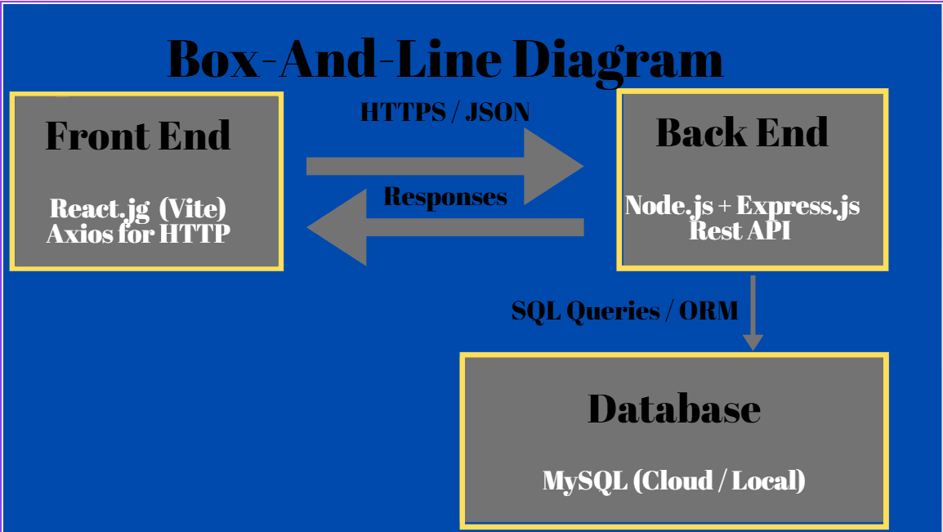

Slide 2
Front end sends HTTP Requests using Axios; GET, POST
Back end will process requests, validate input, and perform SQL queries
MySQL has subscription services and historical pricing data stored
Responses are returned as JSON
HTTPS is what all communication will occur over

Slide 3
Database Design (MySQL)
Table 1 – Subscriptions
Id – (INT, PK, AUTO-INCREMENT
Name – (VARCHAR)
Category (VARCHAR)
Current_Price (DECIMAL)
Table 2 – Subscription_Prices
Id (INT, PK, AUTO-INCREMENT
Subscription_Id (INT, FK – subscriptions.id
Price – (Decimal)
Effective_Date (DATE)

Slide 4
Examples of JSON Output
Using a hypothetical URL: GET/api/v1/subscriptions/popular
Using a hypothetical URL: GET/api/v1/subscriptions/:id/history
{
"id": 1,
"name": "Spotify",
"category": "Music",
"currentPrice": 11.99,
"priceChange": "+2.00",
"lastUpdated": "2025-01-15"
}
{
"success": true,
"data": {
"id": 1,
"name": "Spotify",
"history": [
{ "date": "2023-01-01", "price": 9.99},
{ "date": "2024-01-01", "price": 9.99 },
{ "date": "2025-01-15", "price": 11.99 }
]
}
}
{
"id": 2,
"name": "Apple Music",
"category": "Music",
"currentPrice": 10.99,
"priceChange": "+1.00",
"lastUpdated": "2025-01-10"
}

Slide 5
Data Sensitivity
Data that Could be Sensitive
Database Credentials
User Account Information
Administrative Access Endpoints
How We Will Protect Sensitive Data
Parameterized SQL Queries
Restricted Database User Permissions
Secure Environment Variable Management
Technologies To Protect Sensitive Data
HTTPS
Express Middleware (I.E. helmet, cors)
MySQL User Roles and Permissions
.env Configuration Files

Slide 6
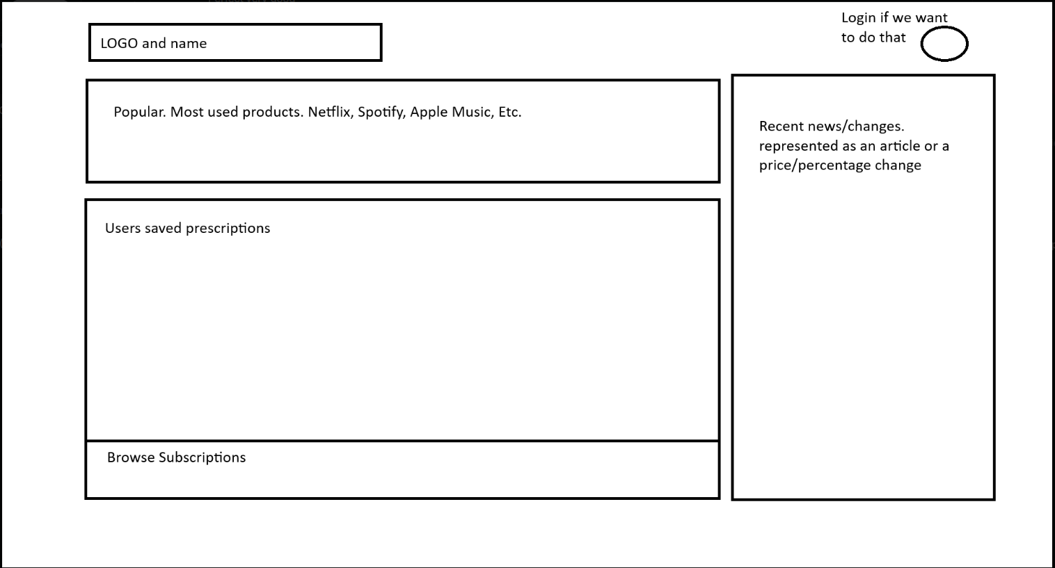
Business Model 1

Slide 7
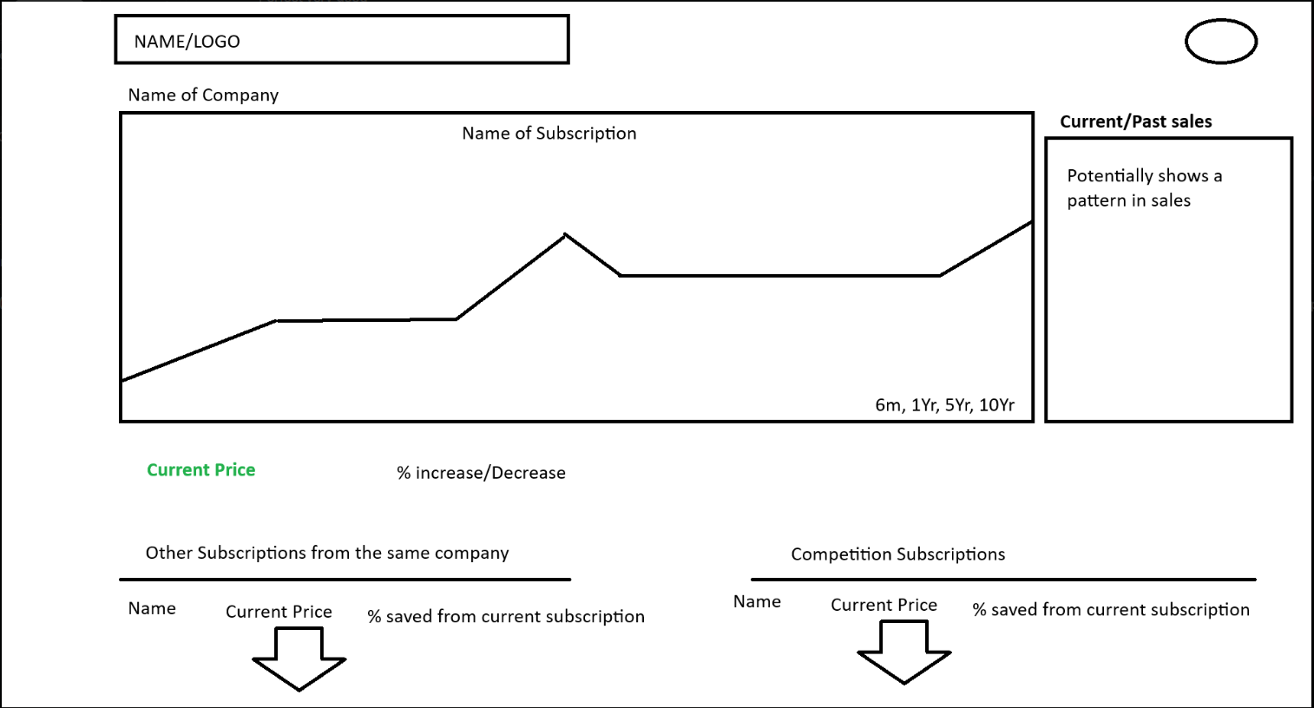
Business Model 2

Slide 8
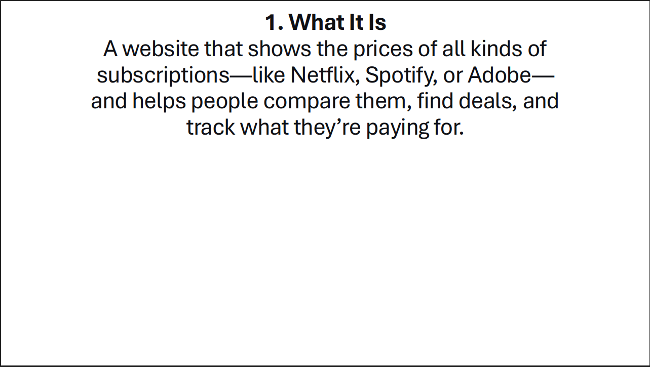

Slide 9
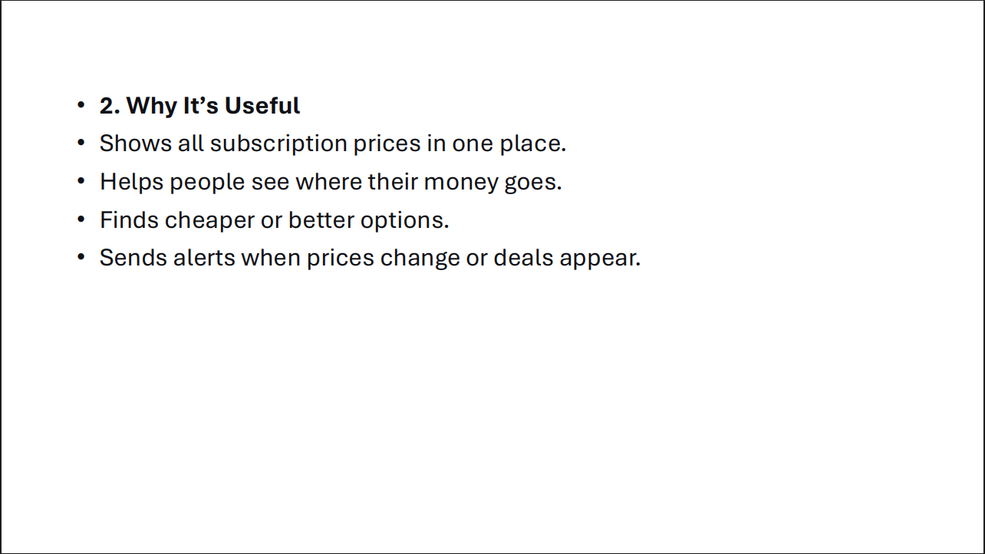

Slide 10
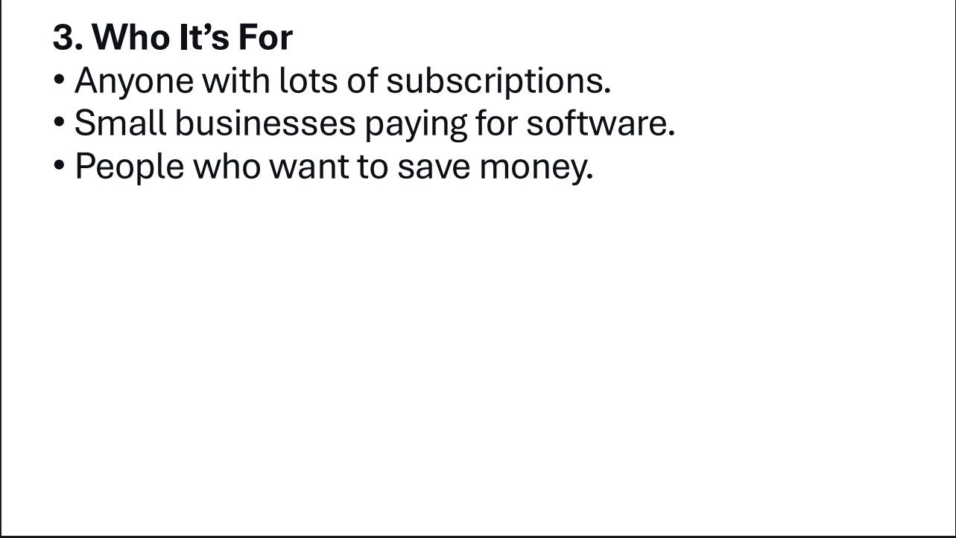

Slide 11
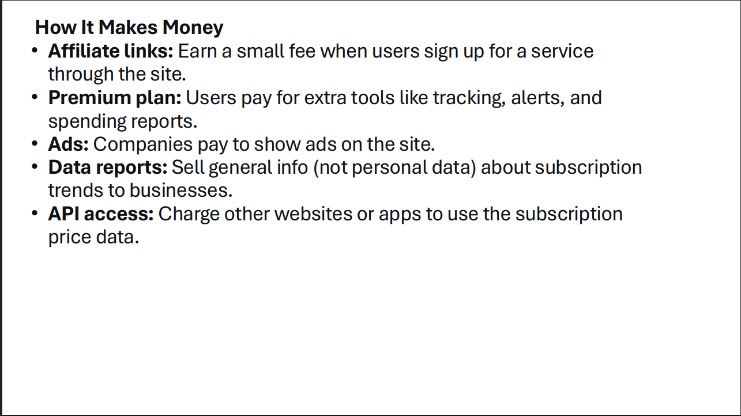

Slide 12
Group
Jared Peck
Casey Altmeyer
Josh Grenninger
Quinton Alexandre

